Slide 1



Expense Sharing App
Money was not made only for saving and accumulating, it was made for sharing and spreading joy
Prepared By:
Tan Vo, Daniel Nguyen, Stephen George, Quan Pham, Mir Ali, Samuel Preston, Amaan Babul, Shriniketh Mukundan

Slide 2
01
About the Project

Slide 3
A mobile expense-sharing app to streamline the process of splitting costs among multiple people.
Objectives
Notes:
Our goal is to simplify shared financial management for roommates, households, travel groups, teams, and event organizers in order to promote transparency and reduce conflicts in real-life scenarios.

Slide 4


Platform Focus:
Streamlined facilitation of expense splitting in group settings, especially meals and group purchases.
Comparison to Existing Apps:
Venmo: Allows splitting bills and expenses, but primarily oriented towards individual transactions, lacking emphasis on group purchases.
Splitwise: Commonly used for splitting expenses among groups; functions as an expense tracker without direct payment features. Ideal for tracking shared costs but lacks direct payment handling.
Industry Comparison

Slide 5
Split Squad
Handles Direct Payments
Direct Bank Access
Partial Payments
Recurring Payments
Friendly UI
The Others
No Direct Payments
Third Party Bank
Fee for Instant Transactions
No Recurring Payments
Why Split Squad?

Slide 6
02
Requirements

Slide 7
Functional Requirements (Representative)
The user shall be able to see and accept or deny a pending split request and, if accepted, pay the expense back partially or in full via a selected payment integration…
The user shall be able to view expense organization such as history of all incoming/outgoing expenses (“I owe you”/”You owe me”)...
The system shall store all user information, friend/group information, …
Nonfunctional Requirements (Representative)
Usability:
User-friendly interface, quick task completion, and high satisfaction.
Performance:
Fast loading, handles heavy traffic, quick backend operations.
Security:
Strong data protection, multi-factor authentication, threat detection, and compliance.
Operational:
High uptime, short maintenance windows for smooth operations.
Regulatory/Ethical:
GDPR compliance, ethical data handling, and fair financial practices.
Requirements

Slide 8
03
Diagrams

Slide 9
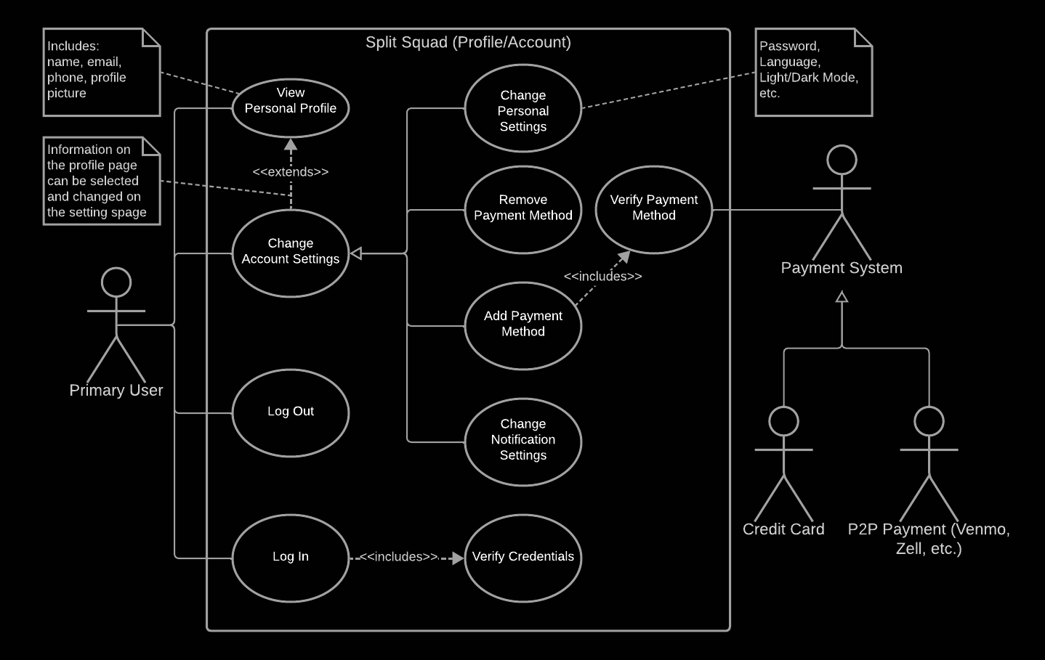
Use Case Diagram
Use Case

Slide 10
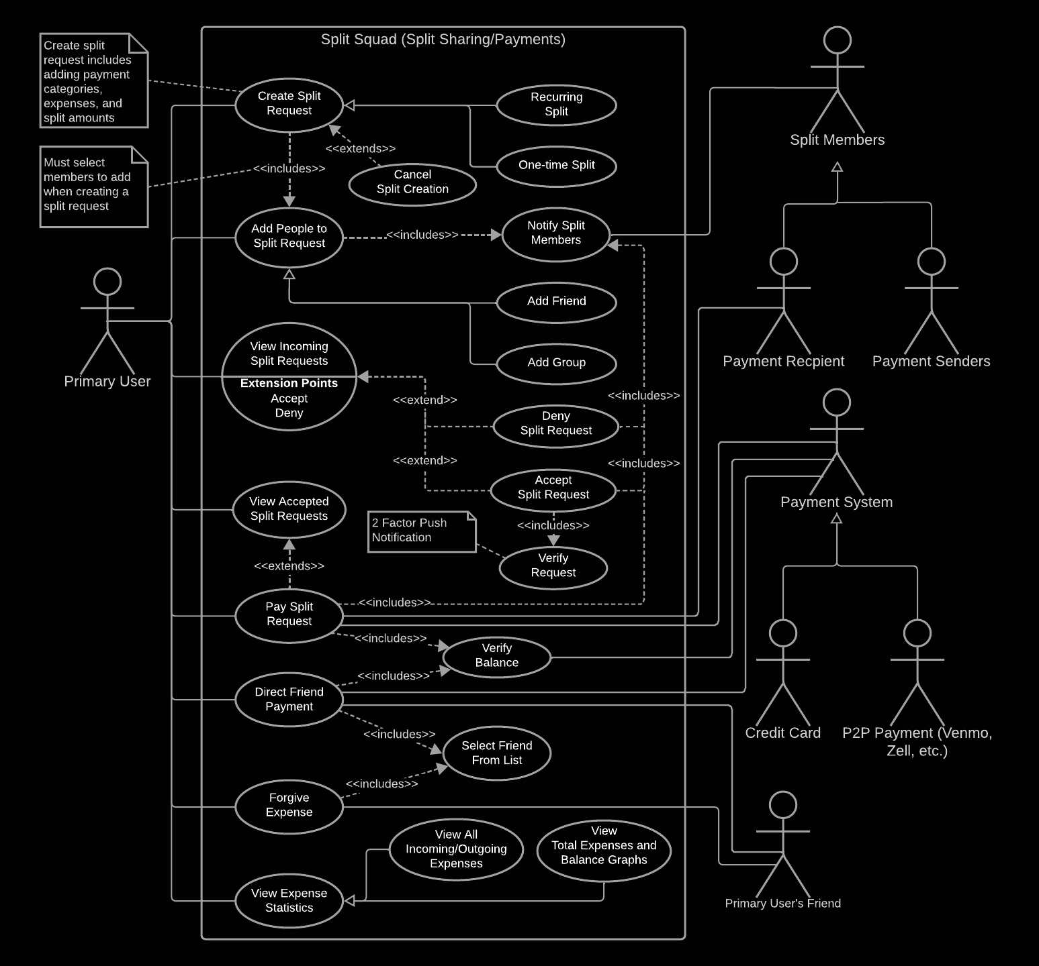
Use Case Diagram
Use Case

Slide 11
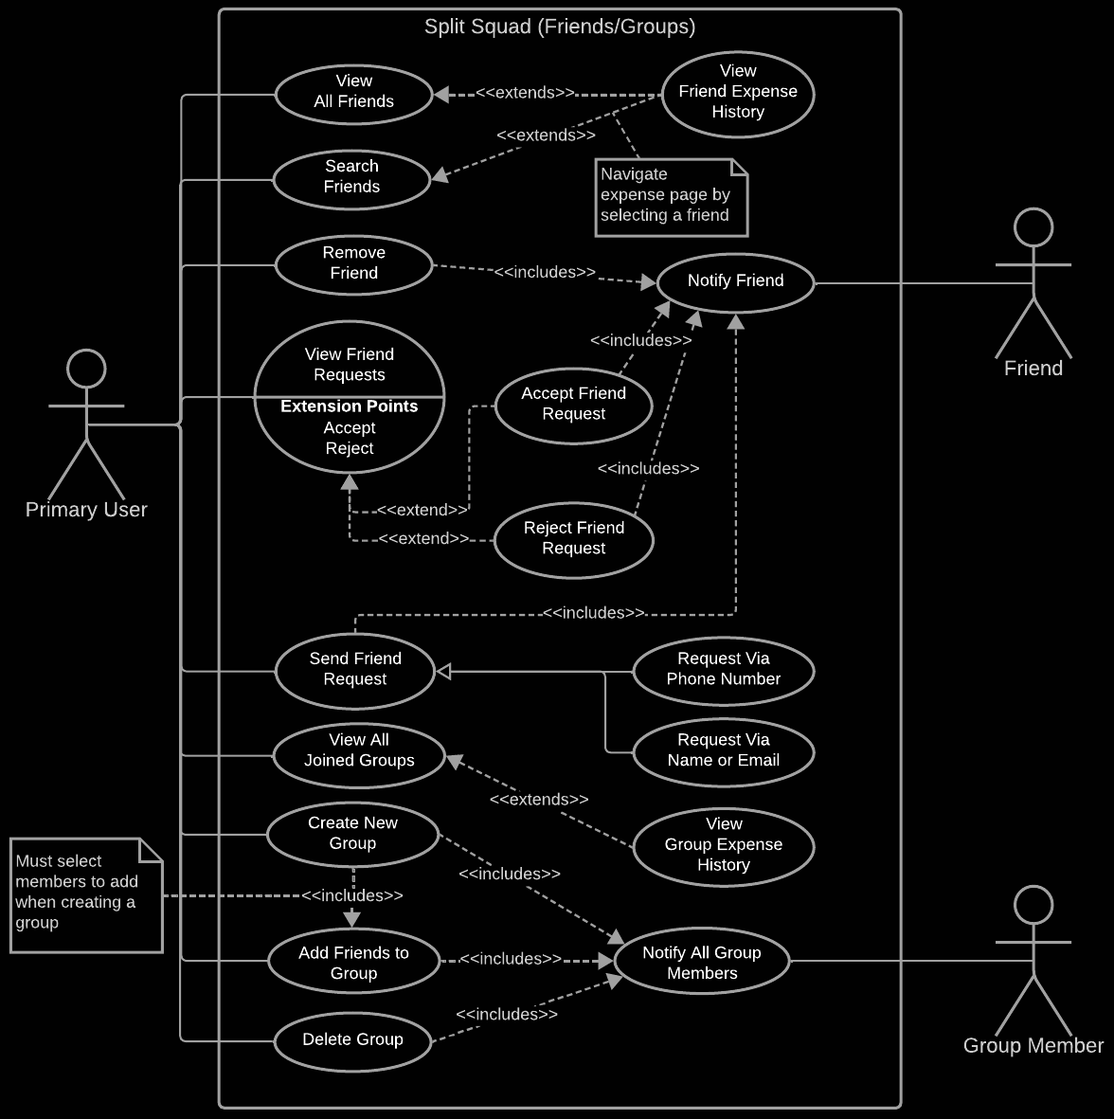
Use Case Diagram
Use Case

Slide 12
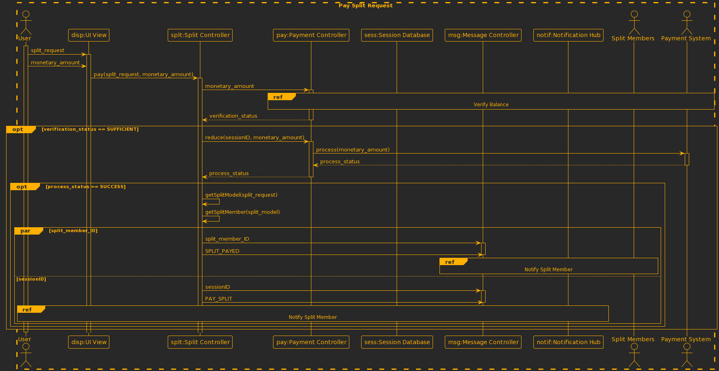
Use case: A user provide payment to a split request
Sequence Diagram

Slide 13
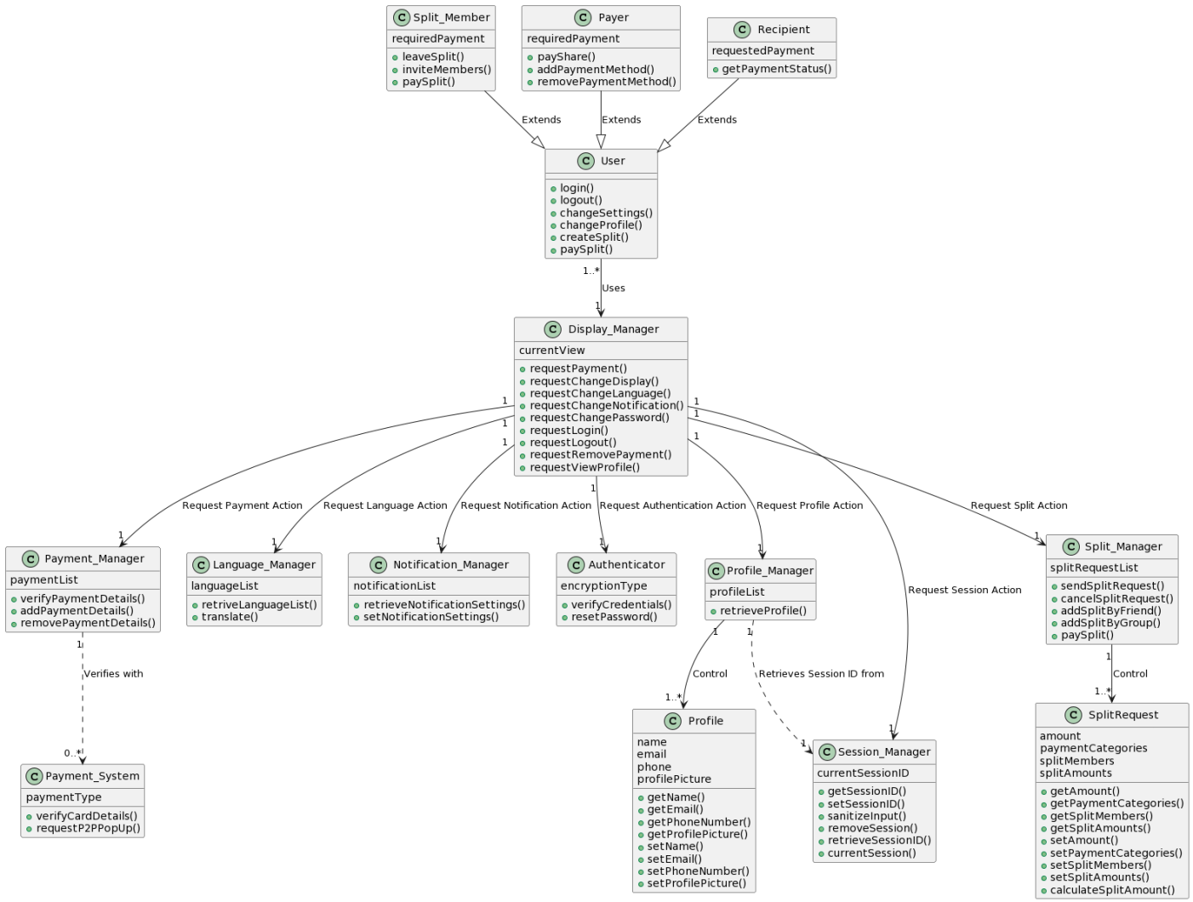
Class Diagram

Slide 14
04
Architecture

Slide 15
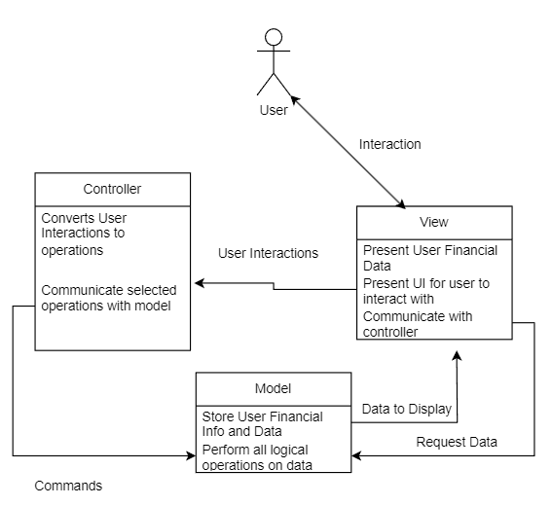
Architecture Pattern

Slide 16
05
Timeline

Slide 17
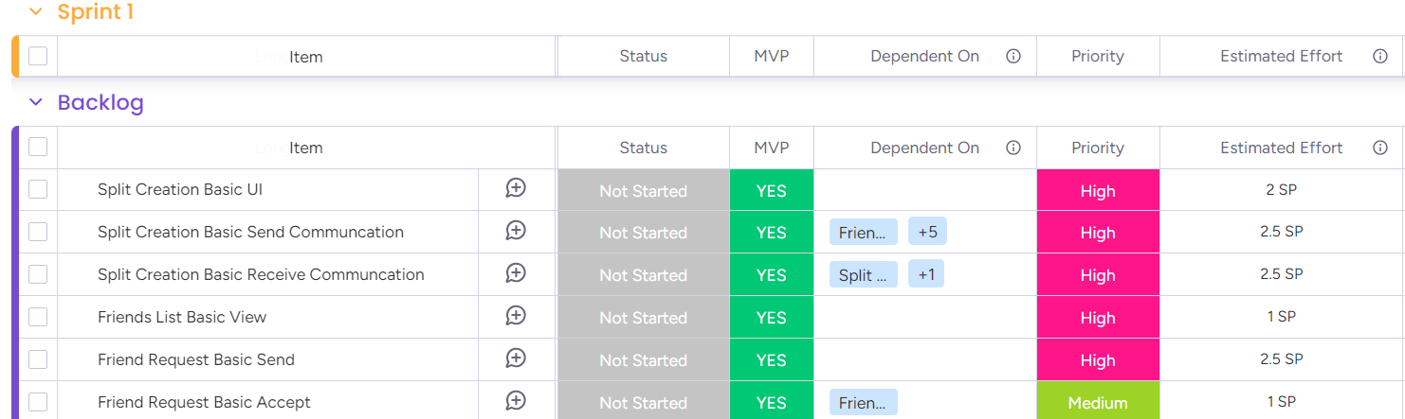
Assumptions
Workdays are 8 hours. Weekends not included.
Schedule follows agile methodology using scrum with 2-week sprints
Software team size is 10
Estimated effort measured in story points (SP)
Average velocity is 2 SP per sprint, so average team velocity is 20 SP per sprint
Product Backlog
30 tasks with a combined 70.75 SP
Timeline

Slide 18
Project Duration
70.75 SP / (20 SP per sprint) = 3.5375 sprints = 1.76875 months
Adjusting for an agreed 75% uncertainty for factors such as volatile requirements and unexpected hurdles
1.76875 x 1.75 = 3.0953125 months ≈ 3 months for flexibility
Task Selection for each sprint
Minimum Viable Product items before non-MVP items
Higher priority items before lower priority items
Because December month has a lot of holidays and vacation leaves, we estimate
• Project start date: January 2, 2024
• Project end date: March 31, 2024
• Project duration: 3 months
Timeline

Slide 19
06
Cost
Estimation

Slide 20
CLOUD SERVICES
Azure Virtual Machine (with IIS Web Server) | $142.35 / month
DATABASE
Azure SQL Database | $289.46 / month
Database Backups | $7.68 / month
SECURITY
Microsoft Defender for Cloud | $29.60 / month
TOTAL COST: $469.27 / month
Hardware Cost

Slide 21
DEVELOPMENT TOOL
Visual Studio Code Professional with Azure DevOps | $438.75 / month
THIRD PARTY API
Stripe Payments | $0
Microsoft Notification Hubs | $10.00 / month
TESTING TOOL
Vite and Vitest | $0
Microsoft Playwright on Azure | $90.50 / month
APP STORE FEE
Apple App Store | $8.25 / month
Google Play Store | $25
TOTAL COST: $547.50 / month + $25 one-time fee
Software Cost

Slide 22
EXPECTED SALARY
Developer (w/ nominal experience) | $6,667 / month
TRAINING
Visual Studio Code | $0
Azure DevOps | $0
Vite and Microsoft Playwright | $300 / month
Vitest | $100
REWARDS/RECOGNITIONS
Employee of the Month | $100 / month
TOTAL COST: $67066.67 / month + $100
Personnel Cost

Slide 23
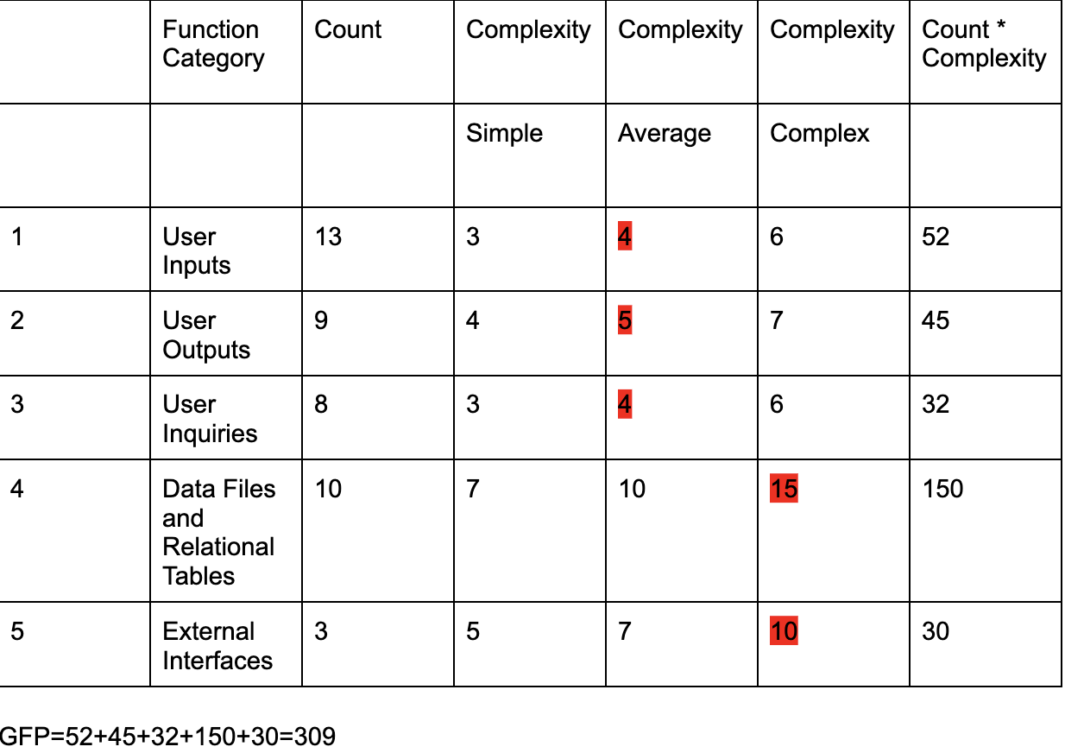
Value Adjustment Factor: Total = 52
PC1=5, PC2=3, PC3=3, PC4=3, PC5=2, PC7=5, PC8=3, PC9=3, PC10=5, PC11=4, PC12=3, PC13=4, PC14=4.
→ PCA=0.65+(0.01*52) = 1.17
Function Points:
FP=1.17*309= 361.53
Assuming there’s 40 FP/person weeks in terms of productivity:
→ 361.53/40=9.03825 person weeks
Function Points

Slide 24
Price Estimation:
Estimated Project Duration: 3 months
Total Hardware Cost: $469.27*3= $1407.81
Total Software Cost: ($547.5*3)+25= $1642.5
Total Personnel Cost: ($67066.67*3)+100= $201,300.01
Total Overall Project Cost: $204,350.32
Selling Price Per User:
Expected Initial Number of Users (within first few months of release): 247.5K
Break Even Cost: $204,350.32/247,500= $0.8257
If we are trying to have a profit margin of 20%, the corresponding selling price per user would be $0.8257*1.2=$0.99 per user.
Price Estimation

Slide 25
07
Testing

Slide 26


Unit Testing: Vitest
Used for testing individual functions and components
Integration Testing: Playwright
Used for testing entire pages and routes
Testing Plan

Slide 27
Vitest Example: Password Hashing
Chose to write test cases for password hashing function
Vital for security
Can easily create input-outputs pairs
Passwords are user inputs, so every possible value type must be tested
import { createHash } from 'node:crypto';
export function generatePasswordHash(password: string, salt: string) {
const hashContent = password + salt;
const hashStr = createHash('sha256').update(hashContent).digest('hex');
return hashStr;
}
Unit Testing

Slide 28
Test Cases
import { describe, it, expect } from 'vitest';
import { generatePasswordHash } from './server';
// Correct hashes generated manually using:
// https://emn178.github.io/online-tools/sha256.html
describe('password hash generation test', () => {
it('returns the correct hash for a common password and salt', () => {
const password = 'password123';
const salt = 'salt123';
const correctHash = 'bb4609fd7ede19a1a39bb73b2b84e41284e.........';
const generatedHash = generatePasswordHash(password, salt);
expect(correctHash).eq(generatedHash);
});
it('returns the correct empty hash for an empty password and salt', () => {
const emptyHash = 'e3b0c44298fc1c149afbf4c8996fb92427ae4.........';
const generatedHash = generatePasswordHash('', '');
expect(emptyHash).eq(generatedHash);
});
it('returns the correct hash for a very long password and salt', () => {
const longPassword = new Array(200).fill('a').join('');
const longSalt = new Array(200).fill('s').join('');
const correctHash = '5cd768ee0d1286342583e9ef8dce5786892.........';
const generatedHash = generatePasswordHash(longPassword, longSalt);
expect(correctHash).eq(generatedHash);
});
// ...
});
First case uses a basic username and password as arguments. Compares output to a known hash.
Next case tests for edge cases by providing empty strings.
Next case provides the opposite: very long strings of 200 characters.
Unit Testing

Slide 29
Final Case
Tests support for non-ASCII characters. Password is made of emojis and salt is made of Hiragana, both Unicode-only character sets.
describe('password hash generation test', () => {
// ...
it('returns the correct hash for non-ASCII characters', () => {
const password = '😂😂👌👌';
const salt = 'ぁぁぁぁ';
const correctHash = 'f386474a7906bb5070f4153aa525f9e............';
const generatedHash = generatePasswordHash(password, salt);
expect(correctHash).eq(generatedHash);
});
});
Unit Testing

Slide 30
Results
All tests passed! Our function works.
All tests were ran concurrently.
> vitest --run
RUN v0.34.6 C:/Users/S/Code/md-y/3354-splitsquad/Implementation
✓ src/lib/util/server.test.ts (4)
✓ password hash generation test (4)
✓ returns the correct hash for a common password and salt
✓ returns the correct empty hash for an empty password and salt
✓ returns the correct hash for a very long password and salt
✓ returns the correct hash for non-ASCII characters
Test Files 1 passed (1)
Tests 4 passed (4)
Start at 19:45:01
Duration 629 ms
Unit Testing

Slide 31
Why We Need Integration Testing
Hash generation is just one part. There are many elements to logging in:
Interfacing with the database
Processing user input
Creating authentication token
Sending response
We can test everything together with Playwright.
Integration Testing

Slide 32
Positive Case
test('login with correct user info', async ({ page, username, password, authSecret }) => {
// Navigate to index page
await page.goto('/');
// Fill in form with test credentials info
await page.getByLabel('Username').click();
await page.getByLabel('Username').fill(username);
await page.getByLabel('Password').click();
await page.getByLabel('Password').fill(password);
await page.getByRole('button', { name: 'Login' }).click();
// Wait until the dashboard is loaded
await page.waitForURL('/dashboard', { timeout: 4000 });
// Check to make sure the authentication token was set as a cookie
const cookies = await page.context().cookies();
const tokenCookie = cookies.find((cookie) => cookie.name === 'splitsquad_jwt');
expect(tokenCookie).not.toBeUndefined();
// Verify the token was sent by our server by using our authentication secret, and decode it
const tokenPayload = jwt.verify(tokenCookie!.value, authSecret) as Record<string, string>;
// Our token is a JWT, so it contains information about our user such as their username
expect(tokenPayload.username).toEqual(username);
// Cleanup
await page.close();
});
Playwright remote controls a browser to simulate user input.
Steps of this case:
Go to login page
Input username/password
Submit
Check if it logged in correctly
Integration Testing

Slide 33
Negative Case
test('login with incorrect user info', async ({ page, username, password, authSecret }) => {
// Navigate to index page
await page.goto('/');
// This will catch the login request response
const loginResponse = page.waitForResponse('/?/login');
// Fill in form with fake credentials
await page.getByLabel('Username').click();
await page.getByLabel('Username').fill(username);
await page.getByLabel('Password').click();
await page.getByLabel('Password').fill('bad password: ' + password);
await page.getByRole('button', { name: 'Submit' }).click();
// Wait for the login response, and expect a 400 range error response
const res = await loginResponse;
const status = res.status();
expect(status).toBeGreaterThanOrEqual(400);
expect(status).toBeLessThan(500);
await page.close();
});
Same as last case, but it logs in with the wrong password.
Makes sure the login page returns an error.
Integration Testing

Slide 34
Results
All tests passed! Our login system works.
Tests used Chromium as the browser, but any browser/device can be used.
Running 2 tests using 1 worker
ok 1 login.spec.ts:5:1 › login with correct user info (5.2s)
ok 2 login.spec.ts:34:1 › login with incorrect password (450ms)
2 passed (9.6s)
Integration Testing

Slide 35
08
Demo

Slide 36
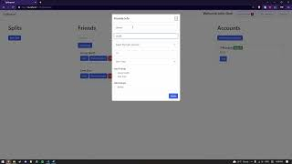
Demo
Demo

Slide 37
09
References

Slide 38
[1] A. of us at monday.com, “Scrum: The definitive guide,” monday.com Blog,
https://monday.com/blog/project-management/scrum/ (accessed Nov. 17, 2023).
[2] W. Vige, “Story points: Estimate user stories in agile [2023],” Asana, https://asana.com/resources/story-points
(accessed Nov. 17, 2023).
[3] D. Radigan, “What are story points in agile and how do you estimate them?,” Atlassian,
https://www.atlassian.com/agile/project-management/estimation (accessed Nov. 17, 2023).
[4] M. Rehkopf, “User stories: Examples and template,” Atlassian,
https://www.atlassian.com/agile/project-management/user-stories (accessed Nov. 17, 2023).
[5] “Monday,” monday.com, https://monday.com/ (accessed Nov. 17, 2023).
[6] Webgraphviz, http://www.webgraphviz.com/ (accessed Nov. 17, 2023).
[7] Microsoft, “Pricing-Microsoft Defender: Microsoft Azure,” Pricing-Microsoft Defender | Microsoft Azure,
https://azure.microsoft.com/en-us/pricing/details/defender-for-cloud/ [Accessed Nov. 16, 2023].
[8] Microsoft, “Pricing - Azure SQL Database Single Database: Microsoft Azure,” Pricing - Azure SQL Database Single
Database | Microsoft Azure, https://azure.microsoft.com/en-us/pricing/details/azure-sql-database/
single/#pricing [Accessed Nov. 16, 2023].
[9] Microsoft, “Pricing - Cloud Services: Microsoft Azure,” Pricing - Cloud Services | Microsoft Azure,
https://azure.microsoft.com/en-us/pricing/details/cloud-services/ [Accessed Nov. 16, 2023].
[10] Microsoft, “Visual Studio Professional - monthly subscription - Visual Studio Marketplace,”
marketplace.visualstudio.com. https://marketplace.visualstudio.com/items?itemName=ms.vs-professional-
monthly#pricing (accessed Nov. 16, 2023).
[11] J. Simonson and K. Main, “Stripe Pricing And Fees (2023 Guide) – Forbes Advisor,” www.forbes.com, 2023.
https://www.forbes.com/advisor/business/services/stripe-pricing-fees/ (accessed Nov. 16, 2023).
[12] Microsoft, “Pricing Calculator | Microsoft Azure,” Microsoft.com, 2023.
https://azure.microsoft.com/en-us/pricing/calculator/ (accessed Nov. 16, 2023).
References

Slide 39
[13] Swing2App, “How much does it cost to publish an app on the app store? | Blog,” Swing2App, Aug. 18, 2022.
https://www.swing2app.com/blog/how-much-does-it-cost-to-publish-an-app-on-the-app-store/ (accessed
Nov. 16, 2023).
[14] “Pricing calculator: Microsoft Azure,” Pricing Calculator | Microsoft Azure,
https://azure.microsoft.com/en-us/pricing/calculator/?service=playwright-testing [Accessed Nov. 15, 2023].
[15] Chcomley, “Get started with Azure DevOps,” Learning path - Training | Microsoft Learn,
https://learn.microsoft.com/en-us/training/paths/evolve-your-devops-practices/ [Accessed Nov. 16, 2023].
[16] J. Charlesworth, “Vite: The Complete Developer’s Guide,” Vite: The Complete Developer’s Guide | Udemy,
https://www.udemy.com/course/vite-developers-guide/ [Accessed Nov. 16, 2023].
[17] B. Alam, “Web Automation and Testing using Playwright,” Web Automation and Testing using Playwright | Udemy,
https://www.udemy.com/course/playwright/ [Accessed Nov. 16, 2023].
[18] “Scalable learning for organizations of every size,” Plans - Udemy Business, https://business.udemy.com/plans/
[Accessed Nov. 16, 2023].
[19] Vladimir, “Getting Started,” Getting Started | Guide | Vitest, https://vitest.dev/guide/ [Accessed Nov. 16, 2023].
[20] What Is Venmo? – Venmo, help.venmo.com/hc/en-us/articles/221011388-What-is-Venmo-. [Accessed 15 Nov.
2023].
[21] “What Is Venmo: How It Works.” Money, money.com/what-is-venmo-how-it-works/. [Accessed 15 Nov. 2023].
[22] “About.” Splitwise, www.splitwise.com/about. [Accessed 15 Nov. 2023].
[23] Reiff, Nathan. “How Splitwise Makes Money.” Investopedia, Investopedia,
www.investopedia.com/articles/company-insights/090816/how-splitwise-works-and-makes-money.asp. [Accessed 15 Nov. 2023].
References

